Slide 1
Grouping Boroughs of London based food category

Slide 2
Introduction
There are many new restaurants opening in London each year, some do well and some not so well
The aim of this project is to group Boroughs of London based on food category to help new / existing restaurant owners
It’s important for restaurant owners to know the specific category and cuisine to target when opening a restaurant in specific Borough or updating menu of existing restaurant to make sure more people visit.
Tourists may have interest in this as well

Slide 3
Data acquisition and cleaning
Wiki – To extract London Boroughs and its co-ordinates
Foursquare – To extract top 100 food venues per Borough
In summary data for all 32 London Borough’s was extracted and approx. 3000 food venues were analysed as part of the project

Slide 4
Methodology - 1
Borough data from Wikipedia was used to get list of all London Borough’s and their co-ordinates
This was then fed to Foursquare API to get top 100 food venues based on the co-ordinates
kMeans clustering was used in the project to group similar Borough’s into cluster different clusters

Slide 5
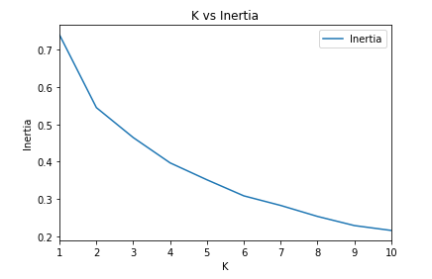
Methodology - 2
Elbow method used to finalize value for K
Since there was a significant drop at k=2, this was used in the final analysis

Slide 6
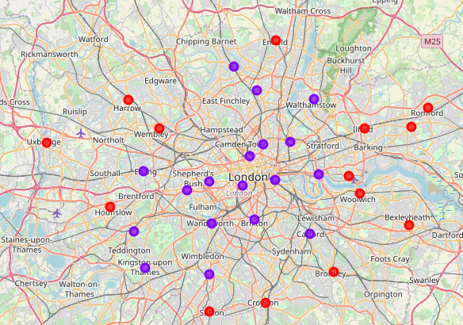
Results
Based on food category, Boroughs near London Main city fall under one group and the Borough’s that are further away fall under another group
Coffee shops and bakeries are more popular in near the city center whereas Fast Food Restaurants are more popular as we move away from city center

Slide 7
Conclusion
For a potential new restaurant owner opening a coffee shop near the city centre gives them a good chance of attracting people in the restaurant. Adding coffee (even take away) may be something that existing restaurant owners can look at if they are close to city centre
We do have to note that there is such a complexity, very different approaches can be tried in clustering and classification studies. Moreover, it is obvious that not every classification method can yield the same high-quality results for London. The details were analysed mainly on popularity provided by Foursquare and these may vary considering day of week and recent conditions (like COVID-19).

